Slide 1
Survey of the Industry

Slide 2
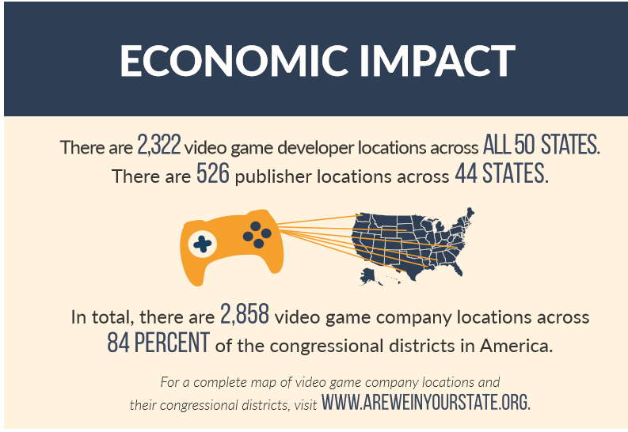
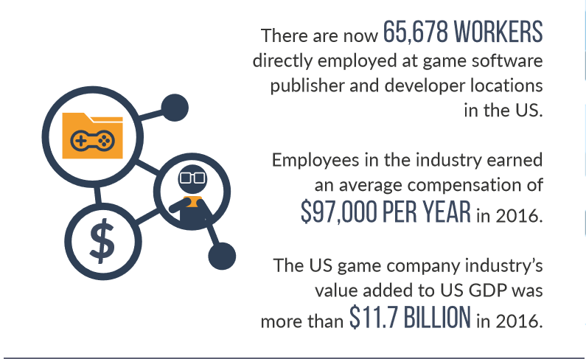
Impact on the Economy
Source: Copyright © http://www.theesa.com, ESA Releases 2017 Annual Report

Slide 3
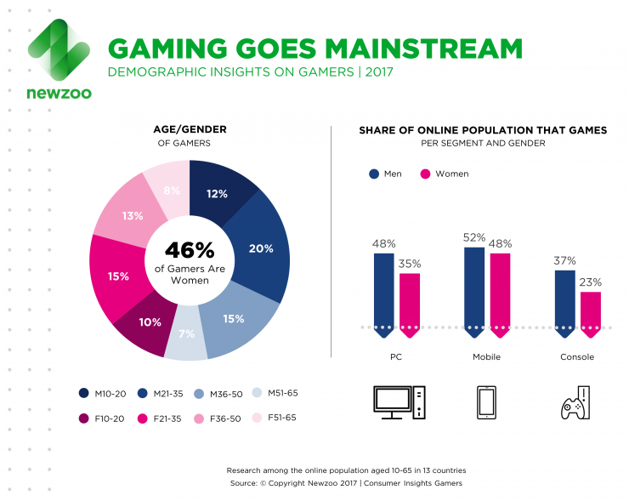
Worldwide Game Industry: Demographics

Slide 4
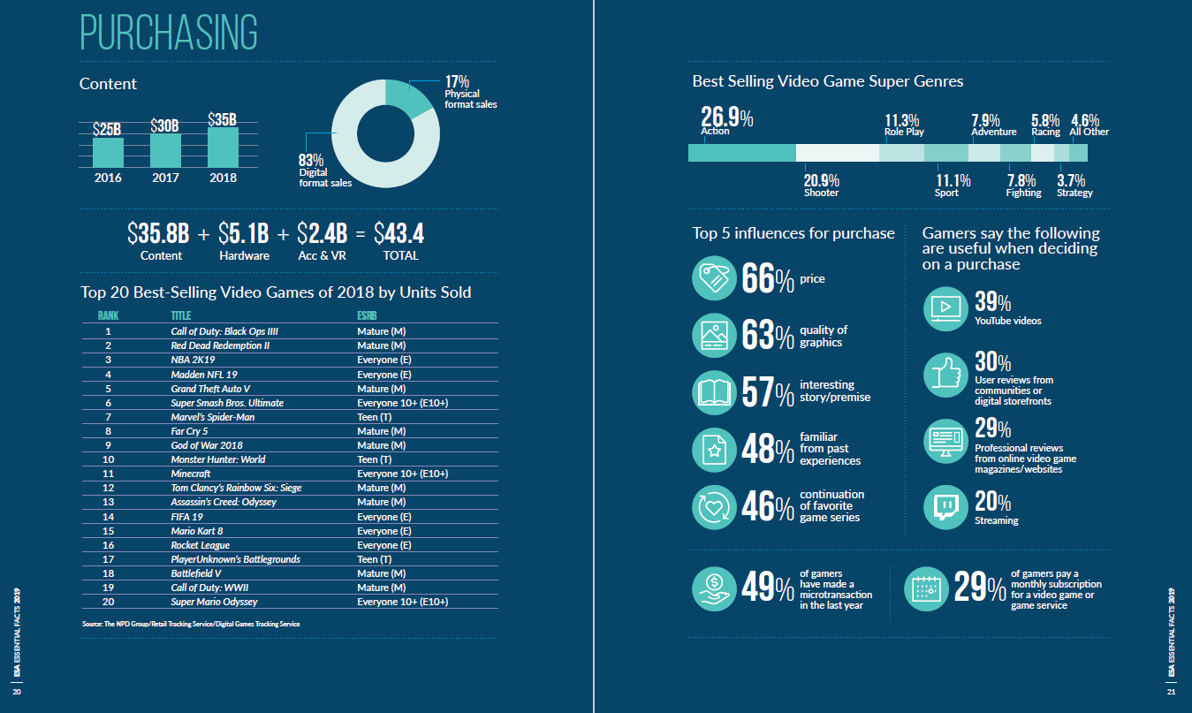

Slide 5
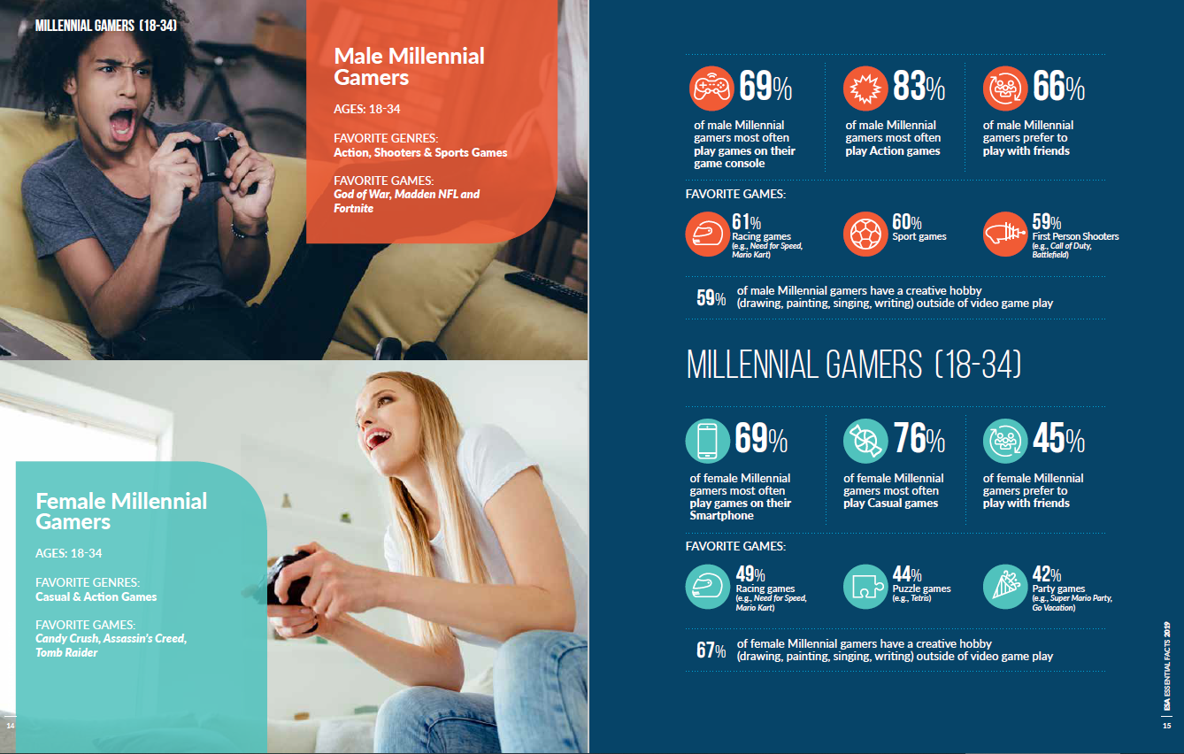

Slide 6
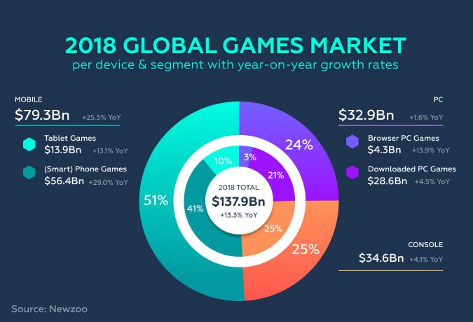
The Game Industry 2018: World-Wide Market

Slide 7
The Game Industry: Market Drivers
Average Age of Video Gamers:
33

Slide 8
Market Drivers
Total number of video gamers worldwide:
2.5 Billion
(about 50% spend money on video games)

Slide 9
AAA Game Industry response: Sequels
What game’s 5th iteration’s 1st week domestic sales ($310M) beat
Black Panther’s 1st week domestic sales ($292M)
&
Infinity Wars 1st week domestic sales ($250M)
?

Slide 10

The Game Industry: Sequels…..

Slide 11

The Game Industry: The biggest Sequel of all…..
Total Sales: 100,000,000 Units
Total Revenue > $6 Billion

Slide 12
The Future of the Industry
Consoles
Will continue to be successful
Pros
Consistent Tech (doesn’t have the constant upgrades required in a PC)
Consistent Quality (Sony and MS have standards in regards to bugs)
Relatively cheap
Advancements in look, audio, and social gaming will give them a long life
They will remain the premium experience
Cons
They do outdate
There is no small model on console
Tablet & Mobile Gaming (iOS & Android)
Huge market with an even higher level of competition
Cost of entry is low; success is now elusive (too much competition)
IPs (Intellectual Properties) are becoming very important

Slide 13
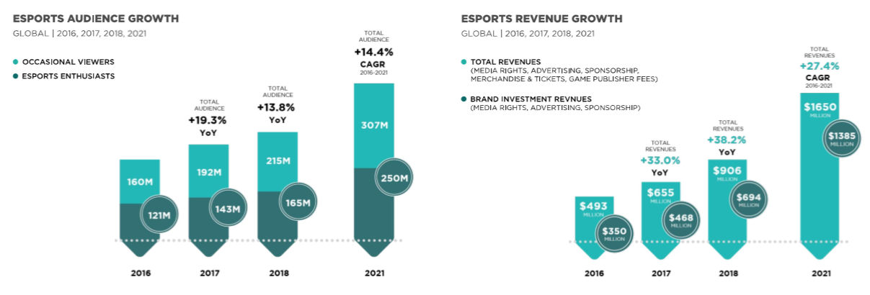
The Future of the Industry
The Emergence of eSports
Source: Copyright © 2018 Newzoo/ Global Esports Market Report 2018

Slide 14
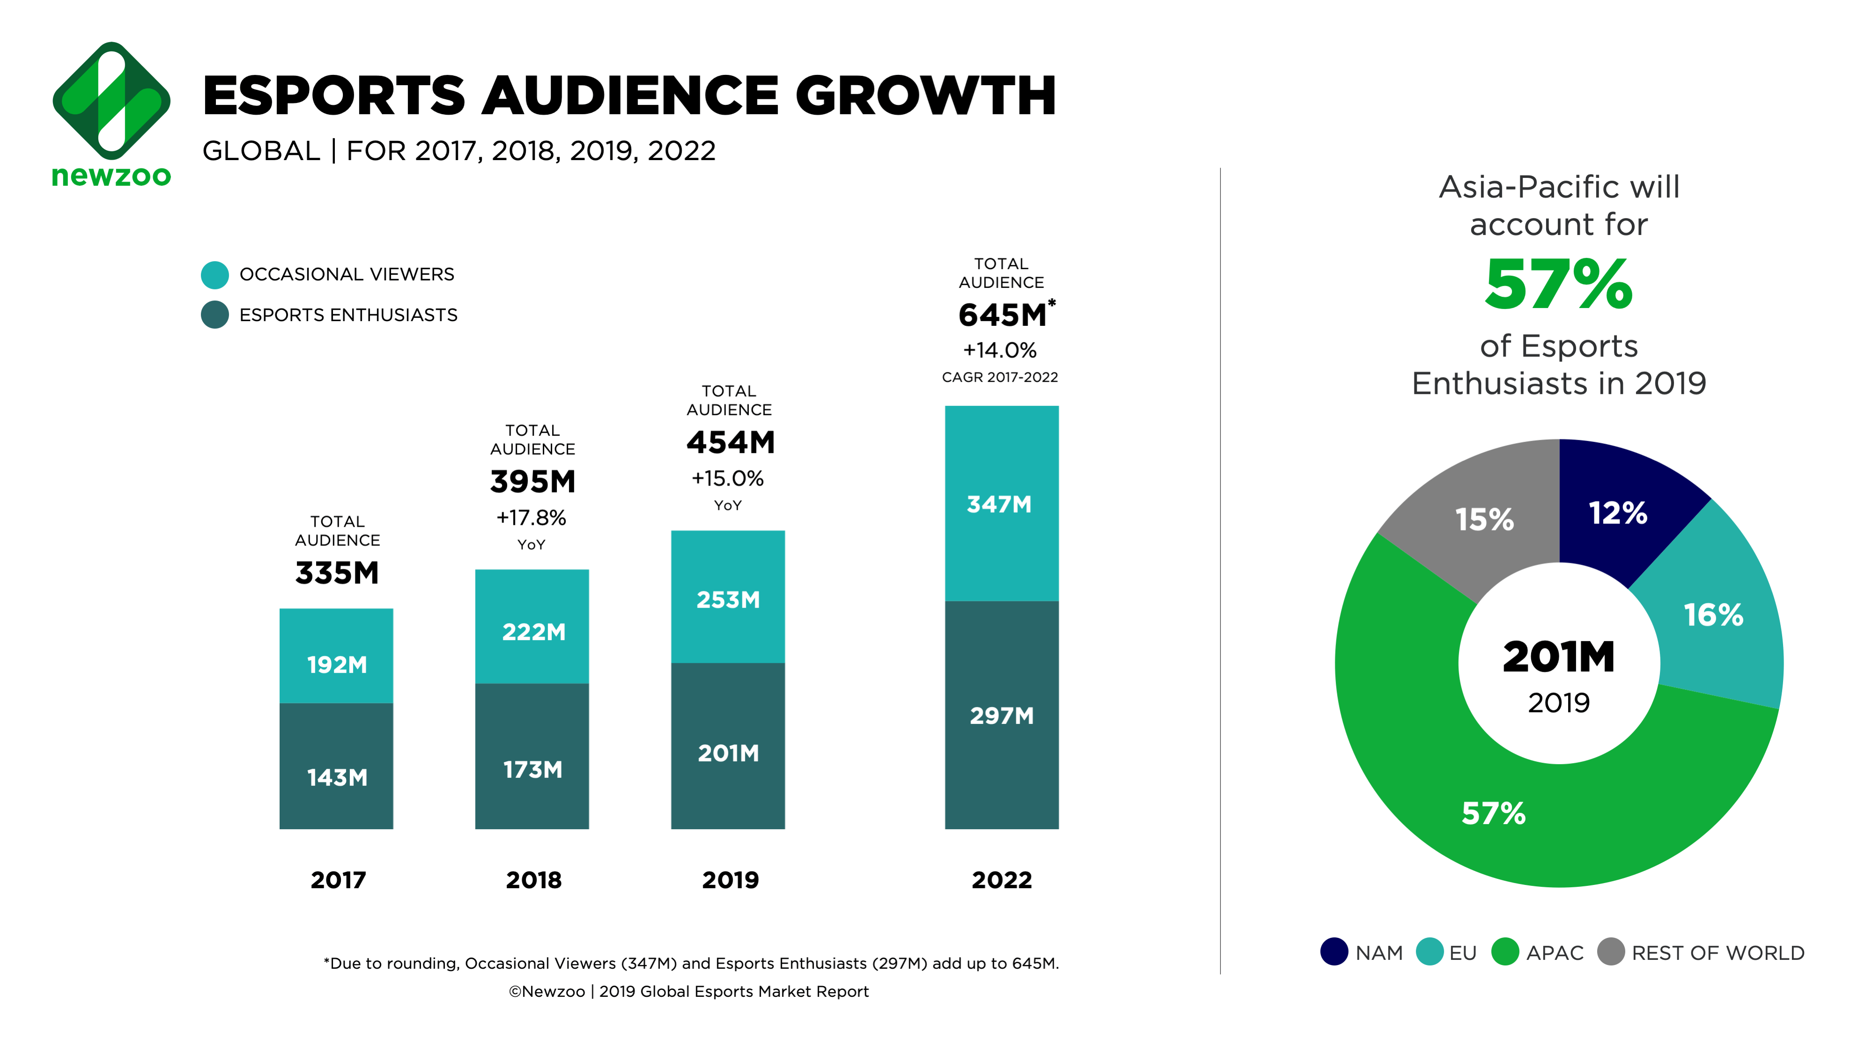
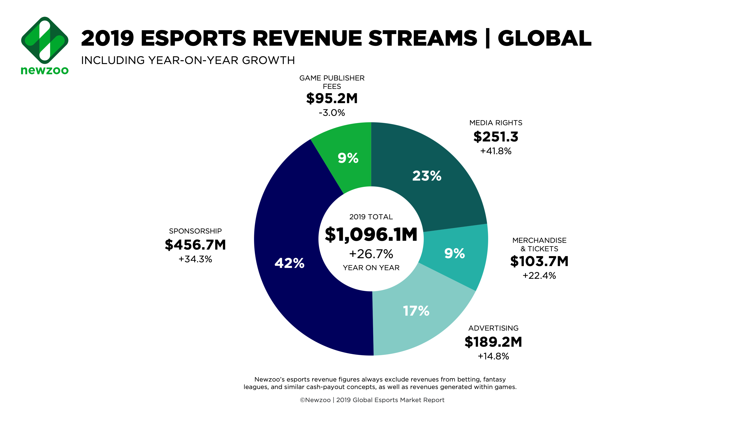
The Future of the Industry
2019 Estimated Esports Revenue
Source: Copyright © 2018 Newzoo/ Global Esports Market Report 2018

Slide 15

Esports Audience (Twitch & Youtube, 2018)
Game Viewers
League of Legends 347.4m
CS:GO 274.9m
DOTA 2 250.4m
Overwatch 101.3m
Hearthstone 54.1m
Source: Copyright © 2018 Newzoo/ Global Esports Market Report 2018

Slide 16
Augmented Reality UI: Immersive
Very interesting opportunities
Hardware makes a difference
Window on the World apps/games are already becoming mainstream
Snapchat, Google Maps, Pokemon Go
Harry Potter Wizards Unite and Minecraft Earth (early access)
Hand and/or Eye Tracking
Interface via visual/auditory feedback
Hololens 2: Shipping before the end of the year: targeting enterprise at $3500
https://www.youtube.com/watch?v=C7QbR2d8RNI
Hololens 2 supplies player position, eye tracking, spatial mapping input, hand position as well as any user input to the PC and the PC streams the rendered images back.
Interface via device
Real World Tactile Feedback: My belief is that Mixed Reality looks to be the future
Mix of a set space and a themed overlay. Ex. Star Wars in Siebel

Slide 17
The Future of the Industry
VR (virtual reality)
VR Pros
New Platform (30% of hardcore gamers are interesting in adding it to their systems)
Very Immersive
VR Cons
Currently needs a High-End system to really experience it properly.
Movement (in game and real time)
Interface
VR Growth Potential
Arcades (controlled environments)
Growing but niche platform/PC market, needs tech, lower price point and a big hit
Business (teaching, sales, HR, communication)
Interesting discussion on LinkedIn regarding 2D in VR
Time Stall: Interface :https://www.youtube.com/watch?v=QRmd3VCh0os&feature=youtu.be&t=858

Slide 18
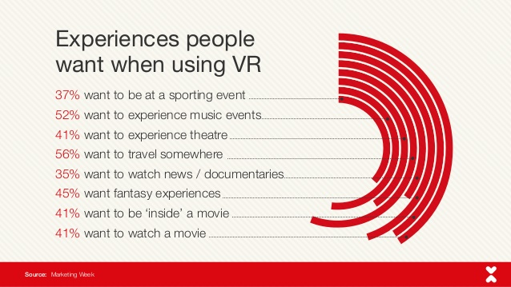

Slide 19
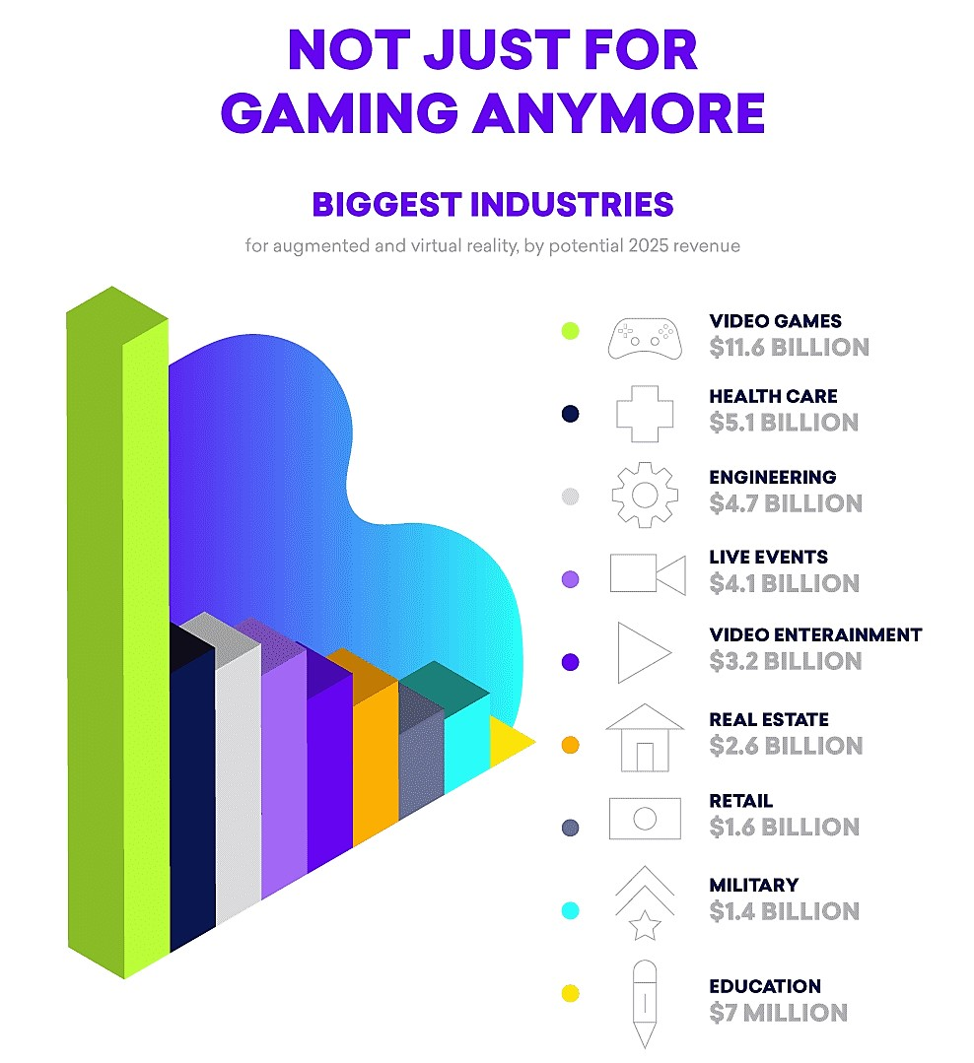
August 2018, nowsourcing.com

Slide 20
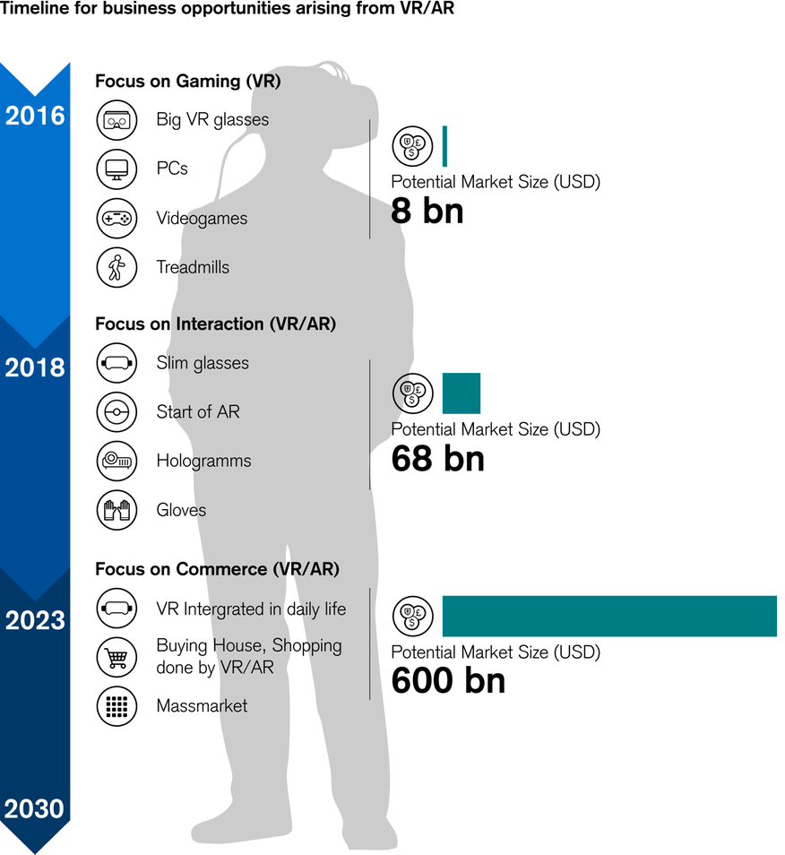
VR Timelines & Expected Goals
© Credit Suisse Oct 2016

Slide 21
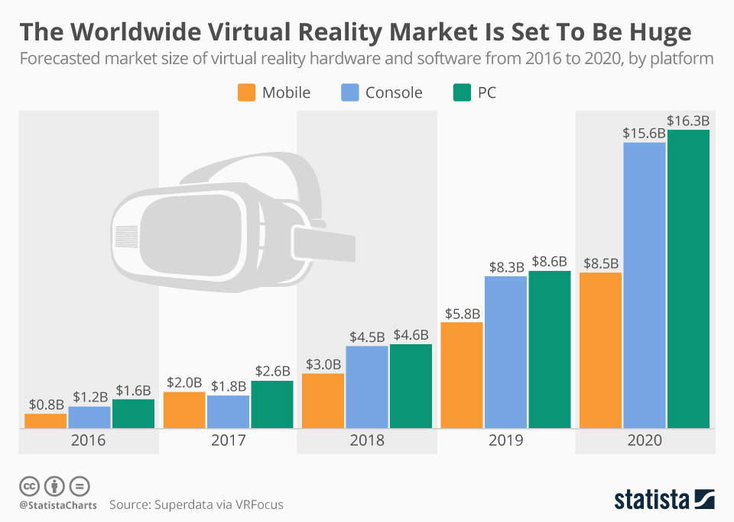
Nov 2016

Slide 22
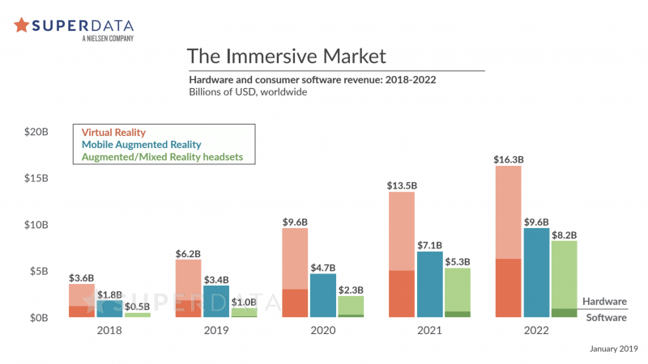

Slide 23
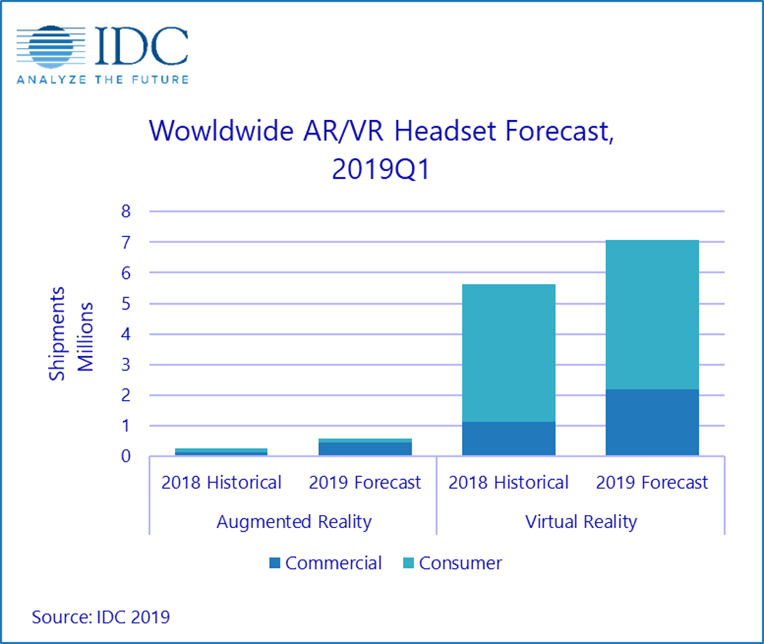
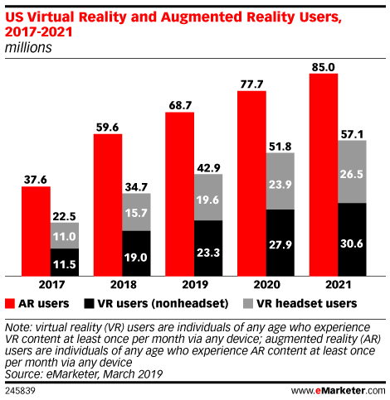

Slide 24
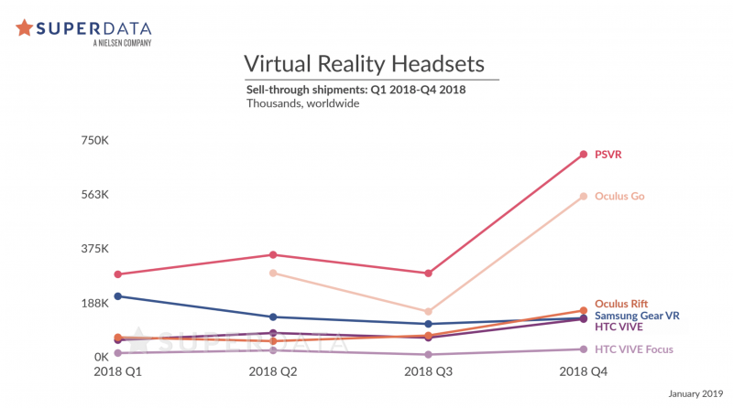

Slide 25
The Future of the Industry: AR Offerings
The Verge: Current status of smart glasses.
Its 2019, where are our Smart Glasses: https://www.youtube.com/watch?time_continue=269&v=da8kICcFHMQ
Apple
AR Glasses: According to channelnews.com, “the glasses are expected to synchronize with a wearer’s iPhone to display things such as texts, emails, maps, and games over the user’s field of vision.”
Amazon Glasses, Echo Frames: Audio AR, linking glasses to Alexa. You can set notifications by swiping the side of the glasses, set reminders, use smart home gear and link to your phone for alerts.
Facebook: Verge.com says “it will produce “multi-layer representations of the world” using crowdsourced data, traditional maps, and footage captured through phones and augmented reality glasses. potential uses — like getting notifications projected in thin air, identifying objects with labels, or even projecting a holographic avatar to hang out with real people.”
Bose: Audio AR: Listening to audio, phone calls, apps connected to the phone).

Slide 26

Industry Issues
Misogyny, sexism and progressivism in video game culture
Gamer Gate
Stereotyping
Main characters match the Developers
Gender Diversity
In-game
In-industry
Racial Diversity
In-game
In-industry
Source: https://gamerant.com/average-video-game-heroes/

